Slide 1

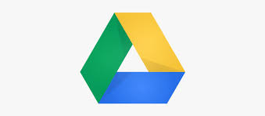
Google Drive

Slide 2

What is Google Drive ?
According to Google Drive “One safe place for all your stuff”, It is a cloud based drive to create, store and edit your documents, spreadsheets and more.
It includes :
Google Docs
Google Sheets
Google slides
Google Keep
Google Forms
Google Drawings
Google App Scripts
Google Fusion Tables
Quickoffice

Slide 3
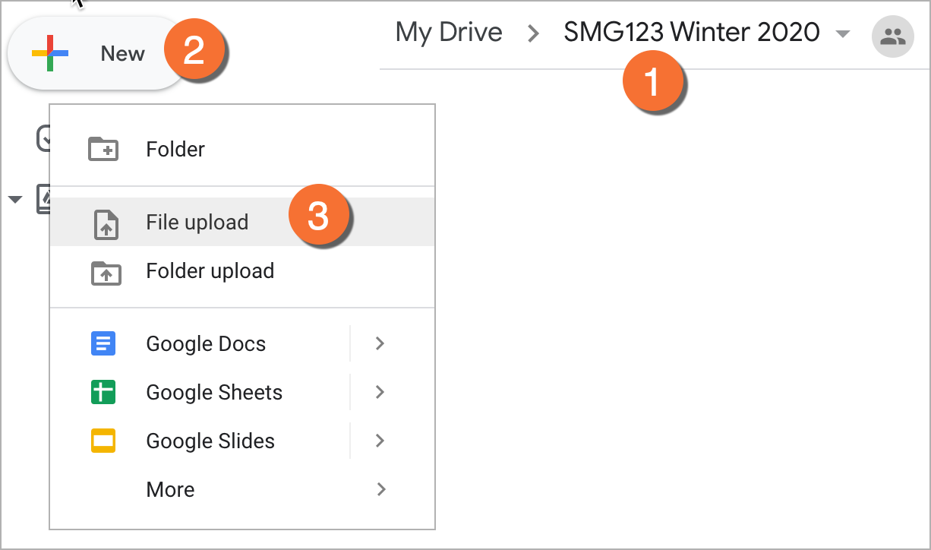
How to upload documents in Google Drive :
Upload and view Files :
On your Android or pc, open the
Google Drive app.
Tap add (+).
Tap Upload
Find and tap the files you want to
upload.
View Uploaded files in My Drive until you move them.

Slide 4
Advantages
Disadvantages
Ability to Access Files from Everywhere.
Ability to edit files.
Compatibility with most devices.
Quick Files Search.
Ability to view different file types.
Easy sharing.
Open discussion.
Free Storage space of up to 15 GB.
Security Risks.
Requires Internet connection.
Has a limit of file size you can upload in a day.
File size limits.
Erratic Third-party applications.
Downloading and uploading speed.
Google browses content save in Google drive.
FYIT_68_HET RAVAL

Slide 5
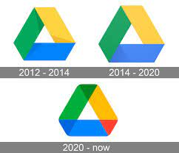
History of Google Drive
TheVerge.com started Google Drive was “The mother of modern world processing” but this just didn’t happen overright.
Idea began in 2005.
Sam Schillace developed a web app called “Writely”.
“Writely” was a simple web-based text-editor.
In 2006 Google acquired this web app.
Started out as an experiment.
Eventually grew to this big idea of a editor with convenience ( it was online/could be accessed anywhere).
Later was adopted by 90% of the company in less than one month.
FYIT_68_HET RAVAL

Slide 6
THANK YOU ☺
FYIT_68_HET RAVAL

